Slide 1





PRESENTATION 2026
Student Name
Student Email
Jeeva T
jeevathangaraj9@gmail.com
Mentor Name
Bharathi Raja

Slide 2

Outline
Abstract of the Project
Problem Statement
Proposed Solution
System Architecture
Live Demo of the Project
Embedded Video of Project
Conclusion
Future Scope

Slide 3
Abstract
This project focuses on analyzing financial and economic data to derive meaningful insights using Business Intelligence and AI tools. The primary objective is to transform raw and complex datasets—such as stock market indices, GDP growth, inflation, unemployment, and commodity prices—into clear, interactive visualizations that support better decision-making.
The purpose of this project is to address the challenge of handling large and fragmented financial data by applying data cleaning, analysis, and visualization techniques. It aims to help users understand market trends, identify risk levels, and explore the relationship between economic indicators and investment performance.
The project utilizes tools such as Microsoft Excel for data cleaning and preprocessing, Microsoft Power BI for building interactive dashboards, and AI tools like Microsoft Copilot and ChatGPT for automated insight generation and report creation.
The expected outcomes include a set of dynamic dashboards that clearly present financial performance, economic stress levels, and investment insights. These outputs enable users to identify trends, detect high-risk periods, and make informed decisions based on data.
A key highlight of this project is the integration of AI with traditional BI tools, allowing faster analysis, automated summarization, and improved clarity of insights. The project demonstrates a practical and scalable approach to modern data analytics, combining technical tools with domain knowledge in finance.

Slide 4

Problem Statement
The core problem addressed in this project is the difficulty in analyzing large, complex, and fragmented financial and economic datasets. Data such as stock indices, GDP, inflation, and market indicators are often scattered and hard to interpret, making it challenging to derive meaningful insights.
This problem is significant because inaccurate or delayed analysis can lead to poor financial decisions, increased risk exposure, and ineffective planning. Understanding market trends and economic conditions is crucial for timely and informed decision-making.
The primary users affected include financial analysts, investors, business decision-makers, and students in the finance and analytics domain who rely on accurate data insights.
Existing tools like Microsoft Excel often provide limited visualization and require manual effort, while many dashboards lack integration of multiple economic indicators. Additionally, traditional approaches do not effectively utilize AI for automated insights.
The scope of this project is limited to analyzing historical financial and economic data using Microsoft Power BI and AI tools. It focuses on data cleaning, visualization, and insight generation, and does not include real-time data processing or advanced predictive modeling.

Slide 5

Proposed Solution
The proposed solution is to develop an integrated Business Intelligence system that combines data cleaning, analysis, and visualization with AI-assisted insights. This approach transforms complex financial and economic datasets into clear, interactive dashboards for better understanding and decision-making.
The methodology involves collecting historical financial data, cleaning and preprocessing it using Microsoft Excel, and performing analysis using Microsoft Power BI. Key metrics such as volatility, risk levels, and economic indicators are calculated using DAX measures. AI tools like Microsoft Copilot and ChatGPT are used to generate summaries, interpret insights, and assist in report creation.
The process includes data ingestion, cleaning, transformation, analysis, visualization, and AI-based insight generation. The final output is a set of interactive dashboards that allow users to explore trends, compare indicators, and identify high-risk periods.
This solution improves upon existing methods by integrating multiple data sources into a single platform, providing dynamic visualizations, and leveraging AI to automate analysis and reporting. Key benefits include reduced manual effort, improved accuracy, faster decision-making, and enhanced clarity of complex financial insights.

Slide 6
System Architecture
Data Input / Source
Processing / Analysis
Data Cleaning: Raw data is first processed using Microsoft Excel and Power BI Query Editor.
Removed duplicate records
Handled missing/null values (replaced or filtered)
Corrected data types (date, numeric, percentage)
Standardized formats (consistent naming, units, date formats)
Applied data validation to ensure accuracy
Data Transformation: The cleaned data is structured for analysis in Microsoft Power BI:
Created calculated columns and measures using DAX
Converted raw values into meaningful metrics (e.g., volatility, growth rates)
Aggregated data (monthly/yearly summaries)
Established relationships between datasets for integrated analysis
Data Analysis: Analytical techniques are applied to extract insights:
KPI calculation (risk levels, economic stress, trends)
Trend analysis using line/area charts
Comparative analysis across indicators (GDP vs market performance)
Interactive filtering using slicers
AI-assisted insights using Microsoft Copilot and ChatGPT for summarization and interpretation
Raw Files (Primary Source): The dataset was collected in the form of CSV/Excel files containing financial and economic data such as stock indices, GDP, inflation, unemployment rates, and commodity prices. These files were imported into Microsoft Excel and Microsoft Power BI for further processing.
Public Data Sources: Data was obtained from publicly available financial datasets (e.g., market data platforms, open datasets like Kaggle, and economic reports).
Manual Data Preparation: Some data formatting and structuring were manually performed to ensure consistency and usability for analysis.
Database / API (Not Used): This project does not include direct database connections or live API integrations; it is based on static, historical datasets.
Data Uploads: Cleaned datasets were uploaded into Power BI for visualization and dashboard creation.

Slide 7
System Architecture
AI / Tool Integration
Output / Dashboard
Microsoft Excel (Data Preparation Layer): Excel is used as the initial stage for handling raw data. Datasets are imported, cleaned, and structured by removing duplicates, fixing formats, and handling missing values. It acts as the foundation before moving data into advanced tools.
Microsoft Power BI (Analysis & Visualization Layer): Cleaned data from Excel is imported into Power BI. Here, data modeling is performed by creating relationships, calculated columns, and DAX measures. Interactive dashboards are built to visualize KPIs such as volatility, economic stress, and investment trends.
Microsoft Copilot (AI Assistance Layer): Copilot is integrated within Microsoft tools to automate tasks like summarizing data insights, suggesting formulas, and generating explanations. It reduces manual effort and speeds up analysis.
ChatGPT (Insight & Reporting Layer): ChatGPT is used externally to generate report content, explain dashboard insights, and refine analysis through prompt-based interaction. It helps convert technical findings into clear, professional explanations.
Overall Integration Flow:
Excel (Data Cleaning) → Power BI (Analysis & Dashboard) → Copilot & ChatGPT (AI Insights & Reporting)
This integration creates a seamless workflow from raw data to intelligent insights, combining traditional BI
Interactive Dashboard (Primary Output): The main output is an interactive dashboard created using Microsoft Power BI. It consists of multiple pages displaying:
Market Performance & Volatility
Economic Stress & Risk Analysis
Investment Insights & Global Impact The dashboard includes KPI cards, line/area charts, pie charts, and slicers that allow users to filter data dynamically and explore insights.
Charts & Visualizations: Various visual elements such as trend graphs, comparison charts, and distribution visuals are used to clearly represent financial patterns, relationships, and risk levels.
Analytical Report: A structured report is generated with the help of Microsoft Excel and AI tools like ChatGPT. It includes explanations of insights, findings, and conclusions in a clear and professional format.

Slide 8
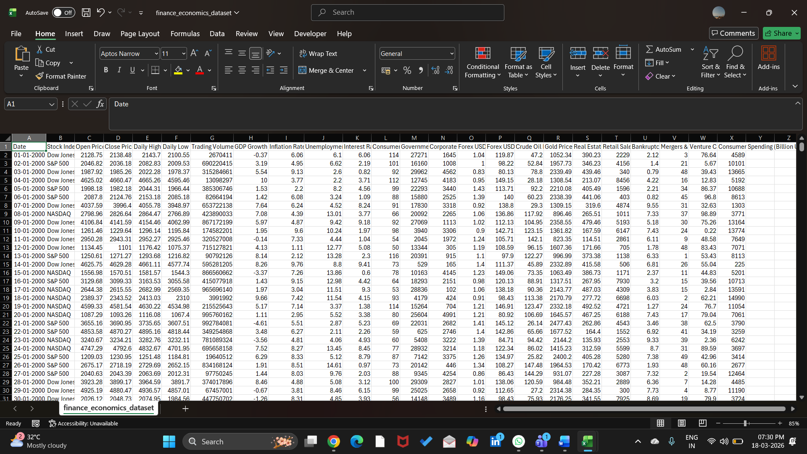
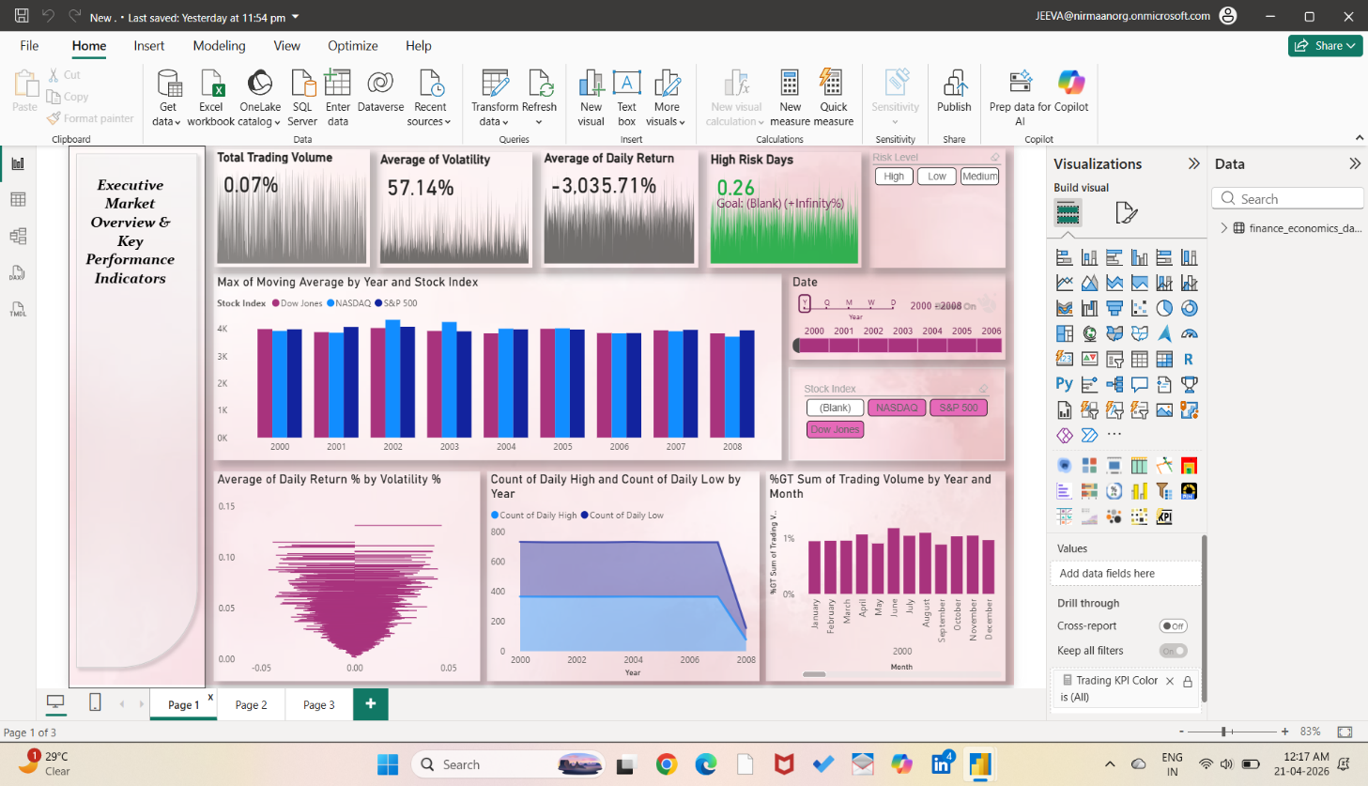
Live Demo of Project
Here's the list of some demo screenshots / features of the project:
Demo 1
Demo 2
Demo 3
[

Slide 9
Video of Project Demo
[C:\Users\jeeva\Downloads\WhatsApp Video 2026-04-21 at 8.20.11 AM.mp4]
▶

Slide 10

Conclusion
This project successfully demonstrated how financial and economic data can be transformed into meaningful insights using Business Intelligence and AI tools. The main objective was to clean, analyze, and visualize complex datasets to support better decision-making, which was effectively achieved through a structured approach.
Using Microsoft Excel for data preprocessing and Microsoft Power BI for visualization, interactive dashboards were developed to represent market performance, economic stress, and investment trends. The integration of AI tools such as Microsoft Copilot and ChatGPT further enhanced the project by enabling faster insight generation and improving the clarity of analysis.
Key findings included the identification of volatility patterns, relationships between macroeconomic indicators and market behavior, and improved data accuracy after cleaning. All the defined objectives were successfully achieved, including data preprocessing, analysis, dashboard creation, and AI-assisted reporting.
Overall, this project adds value to the finance and analytics domain by presenting a practical, scalable approach to data-driven decision-making. It highlights how combining BI tools with AI can simplify complex data analysis, improve efficiency, and support informed decision-making in real-world scenarios.
CONCLUSION

Slide 11
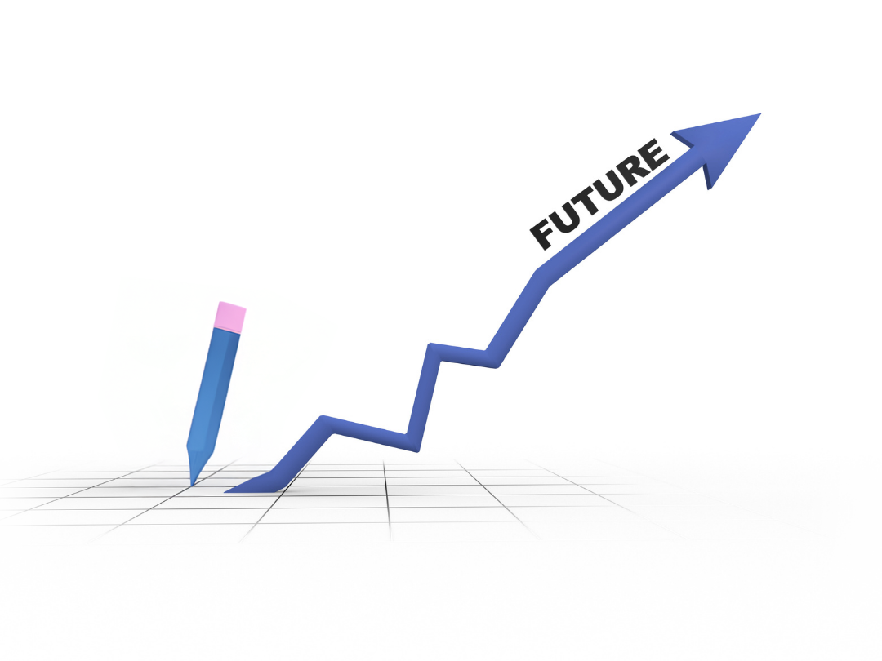
Future Scope
Integrate real-time data using APIs or live connections in Microsoft Power BI for up-to-date analysis.
Implement machine learning models for forecasting market trends, risk prediction, and anomaly detection.
Expand the dataset to include more global financial indicators and diverse data sources for deeper insights.
Develop a web/mobile interface (e.g., Power Apps) for easier access by non-technical users.
Create a standardized prompt library for AI tools like ChatGPT and Microsoft Copilot to ensure consistent and accurate insights.
Enhance dashboards with advanced analytics features such as drill-through, scenario analysis, and predictive visuals.
Enable automated report generation and alerts for critical changes in market conditions.
Improve scalability to handle large-scale datasets and enterprise-level applications.
These enhancements can make the project more powerful, scalable, and suitable for real-world financial and business applications.

Slide 12
Thank You
AICW Fellowship | Student Project Presentation 2026
LinkedIn | Edunet Foundation

